Slide 1
Predictive Modeling of Diabetes Risk Using Health Indicators

Slide 2
Problem Statement
Buisness Understanding
Approach
Data Understanding
Summary of the Dataset
Exploratory Data Analysis
Data Visulaisation
Statistical Analysis
Data Prepartion
Data Modelling
Model Deploymenr
Conclusion

Slide 3
Problem Statement
This project focuses on analyzing the Diabetes Health Indicators Dataset to build a predictive model that identifies whether an individual has diabetes (represented as 0 - No Diabetic, 1 - Diabetic/Pre diabetic). The dataset encompasses a variety of factors, such as:
Health conditions: High blood pressure, high cholesterol, BMI, history of stroke, or heart disease.
Lifestyle choices: Smoking, alcohol consumption, fruit and vegetable intake, and physical activity.
Healthcare access: Availability of healthcare and the ability to afford medical consultations.
Demographics: Age, gender, education level, and income.
Objective: Develop a predictive model to identify individuals at high risk for diabetes (prone to diabetes) based on available data.

Slide 4
Business Understanding
Millions of individuals worldwide suffer from diabetes, a chronic illness that can cause serious health issues like renal failure, neuropathy, and cardiovascular problems.
Medical, demographic, and behavioral factors all have a significant impact on the illness.
The burden of disease can be greatly decreased, quality of life can be enhanced, and healthcare expenses can be decreased with early detection and preventive actions
Stakeholders
"Gen Test," a top pathological testing company in India which aims to introduce a subscription plan called as “Diabetes360”.
Data Privacy Advocates to ensure privacy and ethical use of the data.
The patients, helping them gain awareness and aid them in making lifestyle changes, lifestyle management.
Policy Makers: This project and the subscription in turn can be useful for policy makers.

Slide 5
Approach

Slide 6
Data Pre-processing:
Data Cleaning: Handle missing values, outliers, and inconsistencies.
Feature Engineering: Create new features (e.g., BMI categories, lifestyle risk scores).
Encode categorical variables.
Normalization/Scaling: Scale numerical features for algorithms sensitive to
magnitude.
Data Splitting: Divide the dataset into training (80%), and testing
(20%) sets.
Exploratory Data Analysis (EDA):
Univariate Analysis: Understand the distribution of each variable.
Bivariate/Multivariate Analysis: Identify correlations between features and diabetes
status.
Visualization: Use histograms, scatter plots, heatmaps, etc., to uncover patterns.
Feature Selection:
Identify significant predictors using techniques
Correlation analysis,
Feature importance from tree-based models
Recursive Feature Elimination (RFE)

Slide 7
Model Development.
Logistic Regression.
Decision Trees/Random Forests.
Gradient Boosting (e.g., XGBoost, LightGBM).
Use hyperparameter tuning (GridSearchCV or Random SearchCV) to optimize models
Validation and Testing:
Evaluate models using the validation dataset.
Perform final testing on the test dataset to assess generalizability.
Post-Model Analysis:
Residual Analysis: Understand model errors.

Slide 8
Data Understanding

Slide 9
Defining Feature Groups
Categorical Features | Ordinal Features | Continuous Features
HighBP HighChol CholCheck Smoker Stroke HeartDiseaseorAttack PhysActivity Fruits Veggies HvyAlcoholConsump AnyHealthcare NoDocbcCost DiffWalk Sex | GenHlth Age Education Income | BMI MentHlth PhysHlth
The data contains 22 features and 253,680 examples.
Data Source: https://www.kaggle.com/datasets/alexteboul/diabetes-health-indicators-dataset

Slide 10
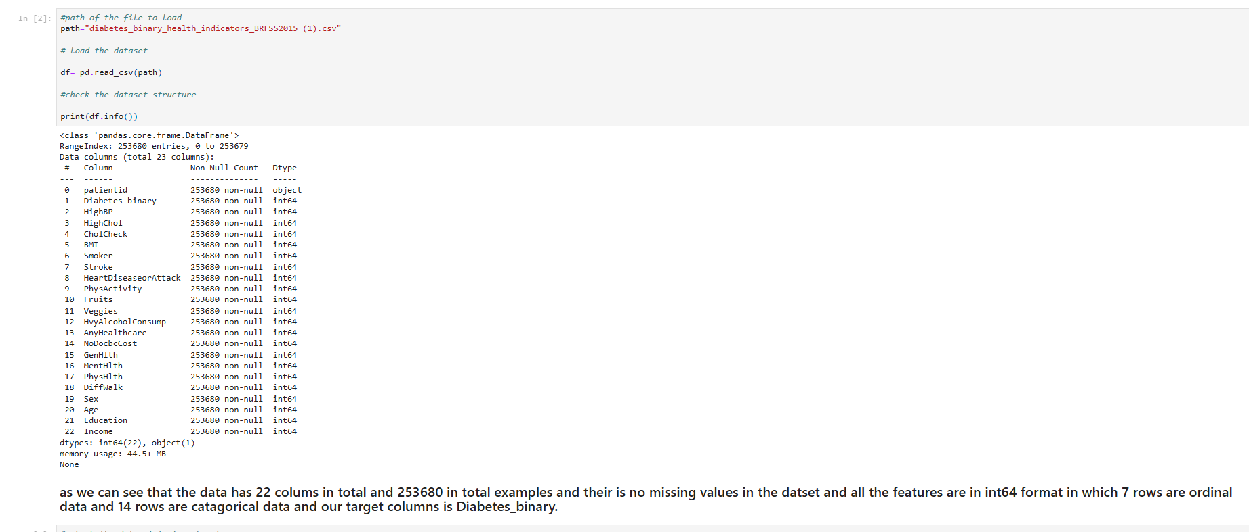
Summary of the Dataset

Slide 11
Exploratory Data Analysis

Slide 12
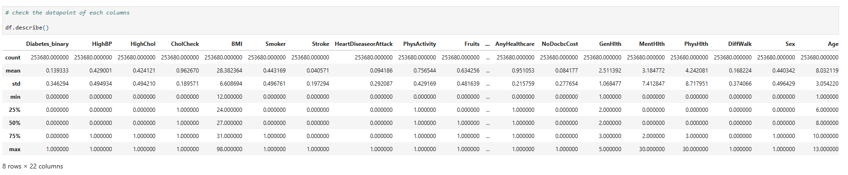
Description of Data

Slide 13
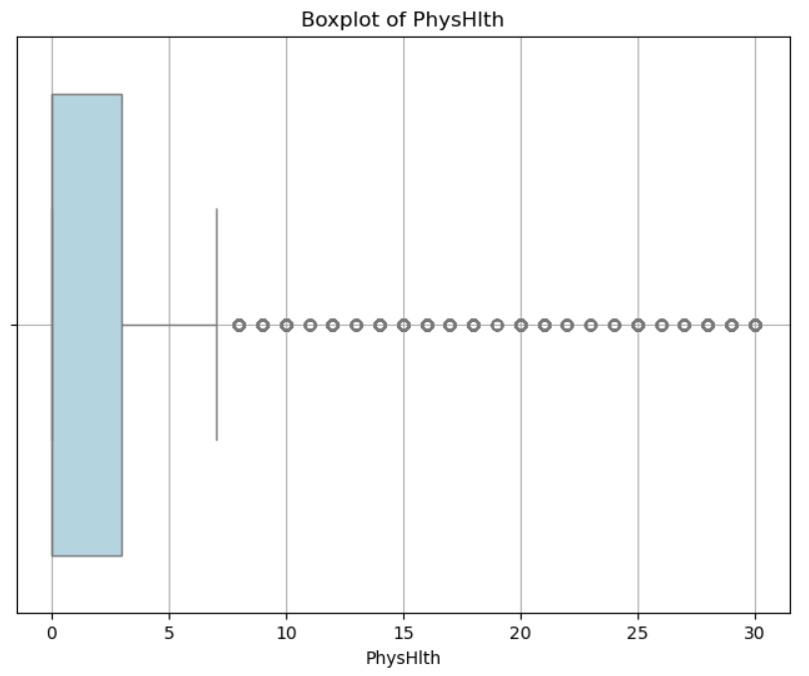
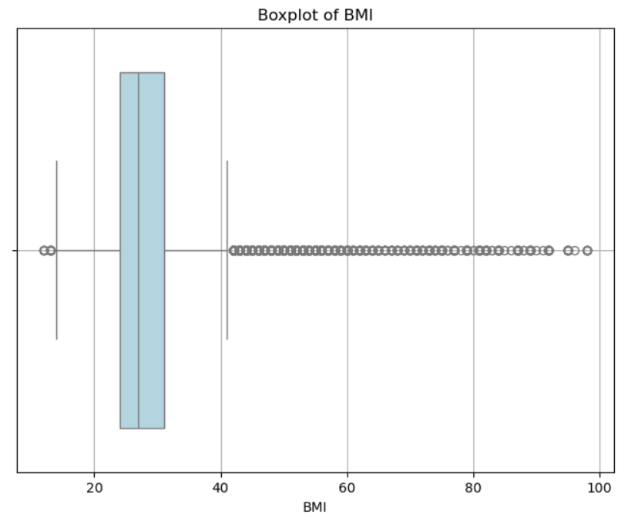
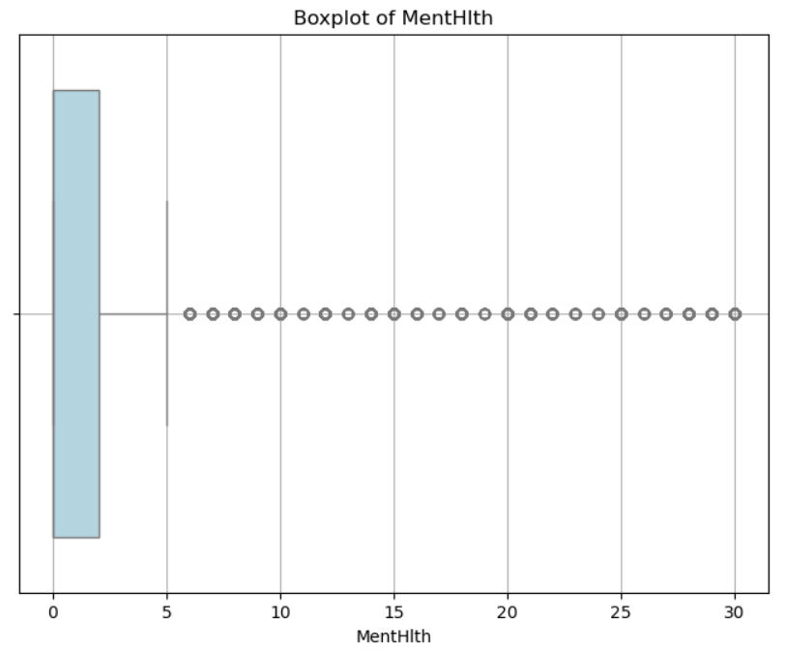
Data Distribution For Continuous Features
(Box Plots)
MentHlth Outliers Count: 36208
BMI Outliers Count: 9847
PhysHlth Outliers Count: 40949

Slide 14
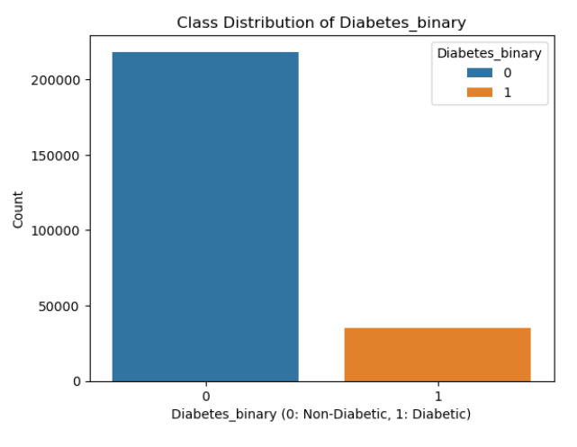
Class Distribution In Data
Class Distribution Analysis
Target Variable (Diabetes_binary):
Class 0 (Non-diabetic): 218,334 samples (86%)
Class 1 (Diabetic): 35,346 samples (14%)

Slide 15
Data Visualisation

Slide 16
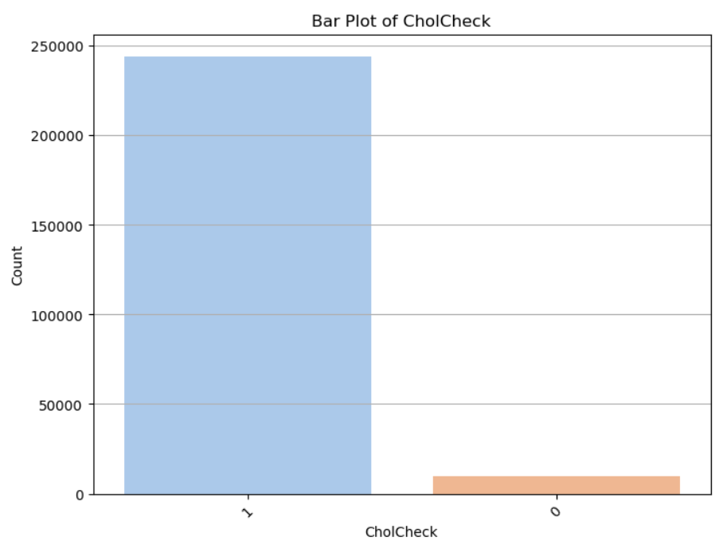
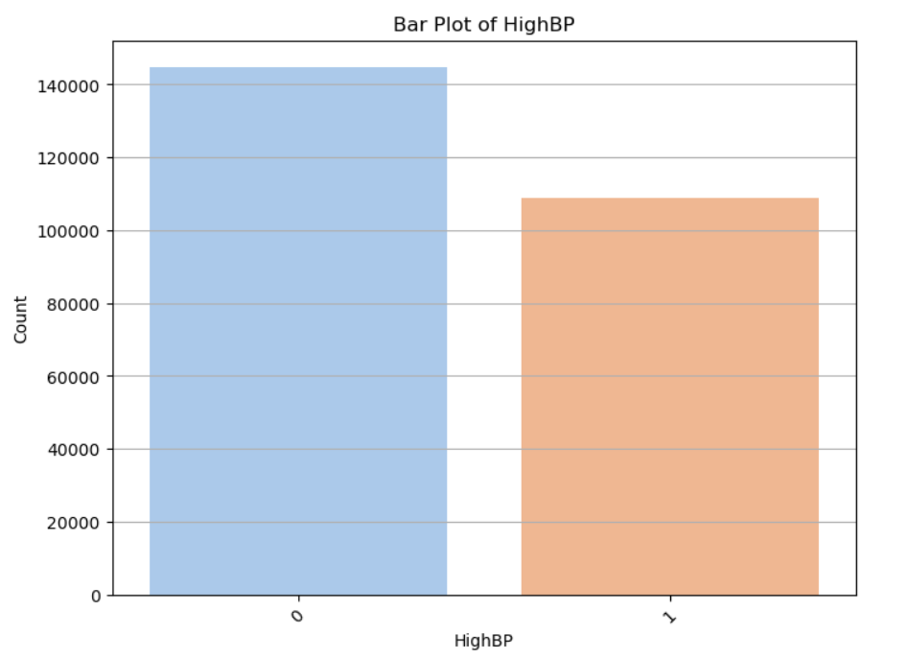
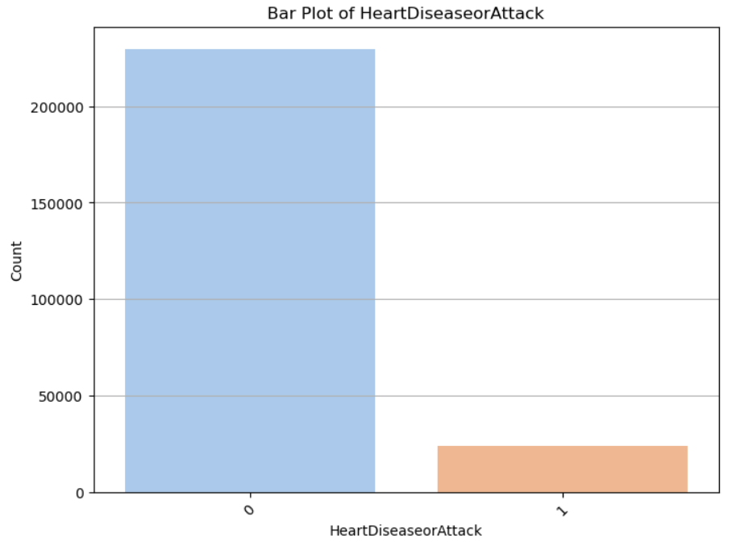
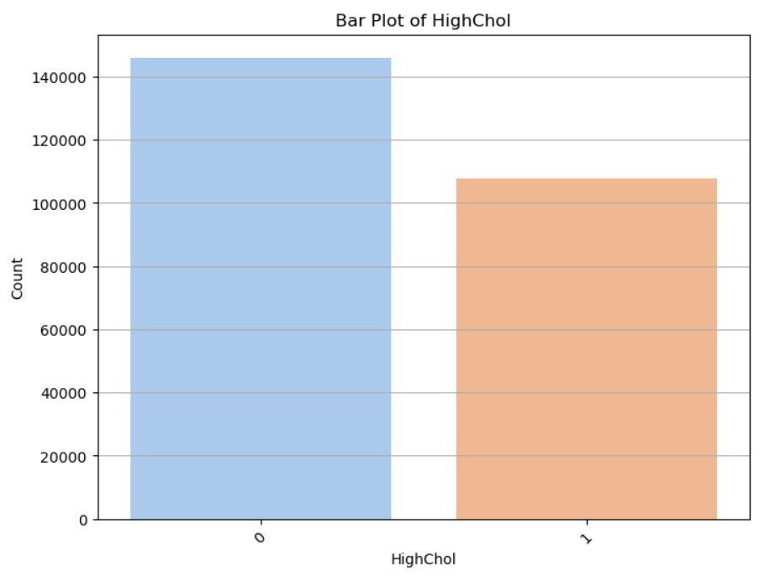
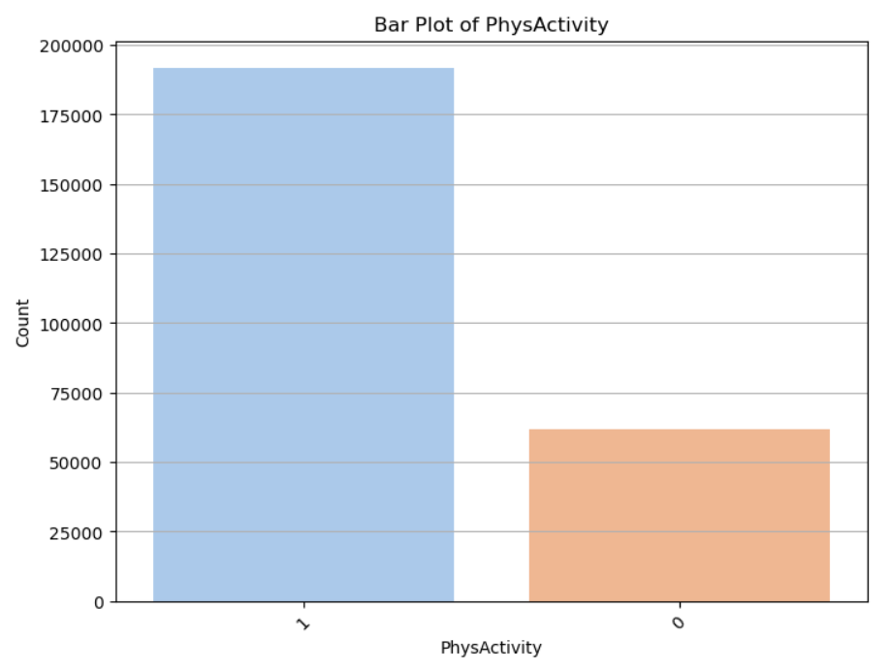
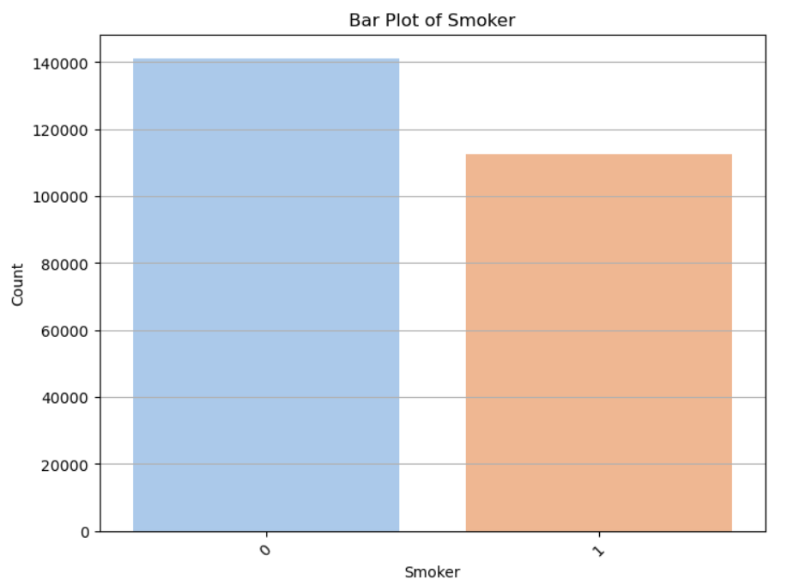
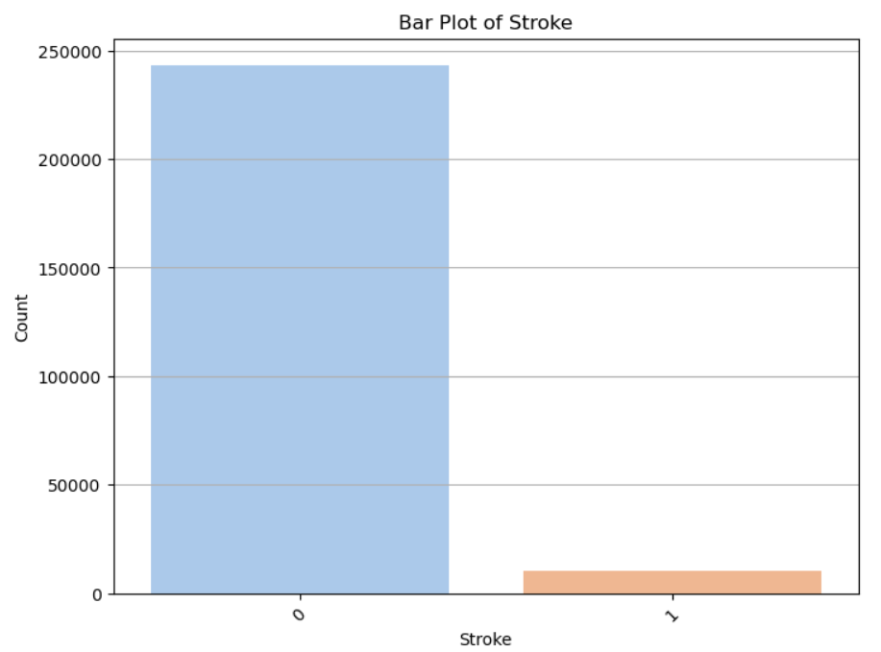
Data Distribution For Categorical Features
(Bar Plots)

Slide 17
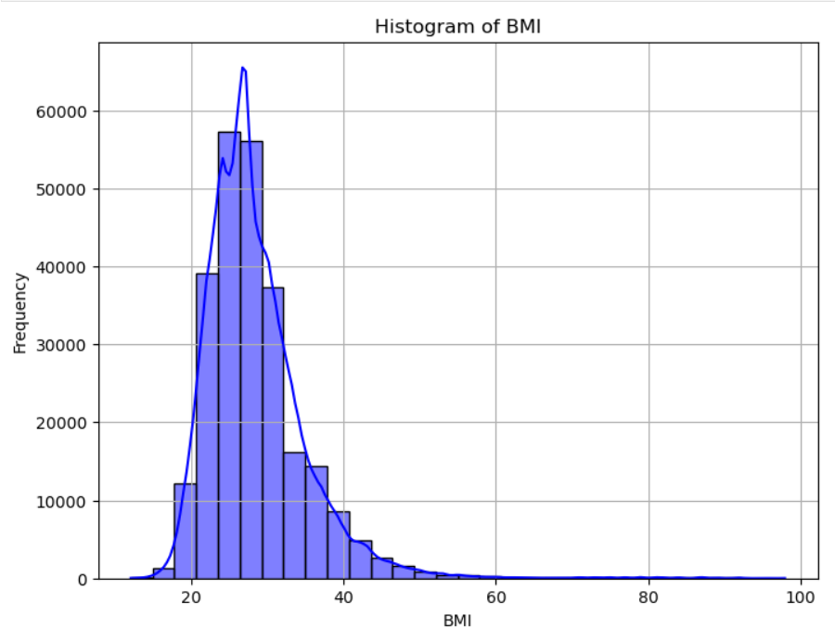
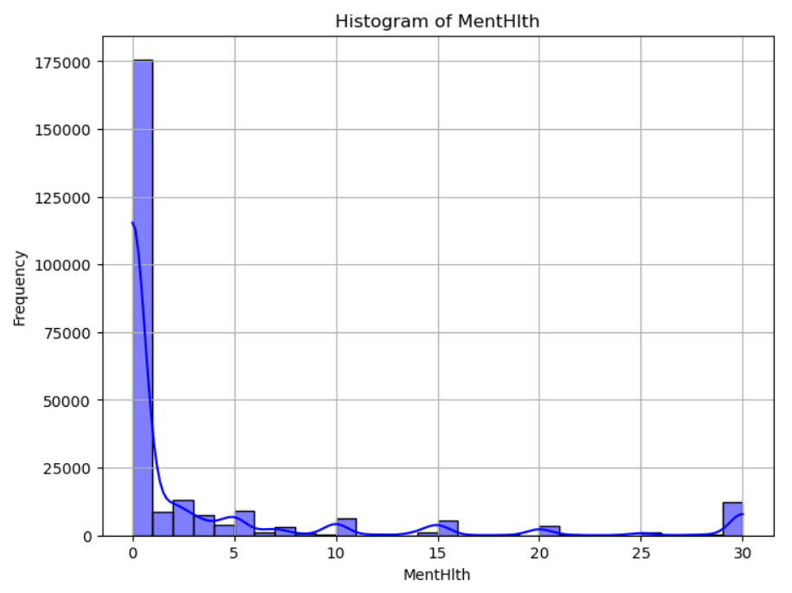
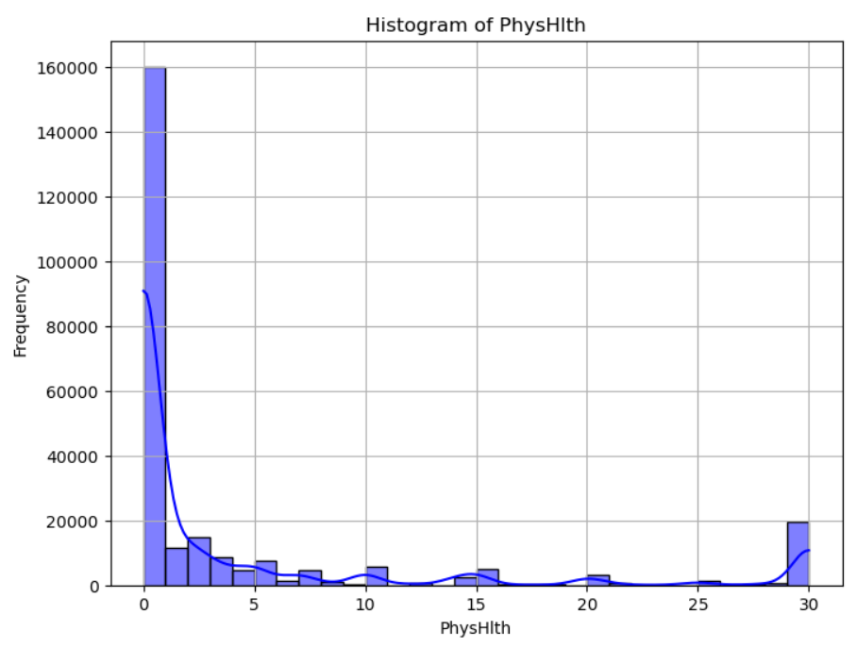
Data Distribution For Continuous Features
(Histogram Plots)

Slide 18
Statistical Analysis

Slide 19
Statistical Analysis For Ordinal Data
Shapiro-Wilk Test for Normality
Purpose: Assess if numerical variables (BMI, GenHlth, MentHlth, PhysHlth, Age, Education, Income) deviate from normality.
Hypotheses:
H₀: Data follows a normal distribution.
H₁: Data does not follow a normal distribution.
Decision Rule:
p-value ≤ 0.05: Reject H₀ (not normal).
p-value > 0.05: Fail to reject H₀ (normal)..
BMI:
Group 0 (non-diabetic) p-value: 0.00000
Group 1 (diabetic) p-value: 0.00000
MentHlth:
Group 0 (non-diabetic) p-value: 0.00000
Group 1 (diabetic) p-value: 0.00000
PhysHlth:
Group 0 (non-diabetic) p-value: 0.00000
Group 1 (diabetic) p-value: 0.00000
Shapiro-Wilk test results show all features for both groups (diabetic and non-diabetic) are not normal (p-values < 0.00001), rejecting the null hypothesis.

Slide 20
Mann-Whitney U Test (Non-Parametric)
Purpose: Compare means of a numeric variable (e.g., BMI) between diabetic and non-diabetic groups.
Hypotheses:
H₀: No significant difference in means.
H₁: Significant difference in means.
Decision Rule:
p-value ≤ 0.05: Reject H₀ (difference exists).
p-value > 0.05: Fail to reject H₀ (no difference).
BMI:
Mann-Whitney U Test p-value: 0.00000
MentHlth:
Mann-Whitney U Test p-value: 0.00000
PhysHlth:
Mann-Whitney U Test p-value: 0.00000
GenHlth:
Mann-Whitney U Test p-value: 0.00000
Age:
Mann-Whitney U Test p-value: 0.00000
Education:
Mann-Whitney U Test p-value: 0.00000
Income:
Mann-Whitney U Test p-value: 0.00000
All tests show statistically significant differences (p-value = 0.00000) for all variables between diabetic and non-diabetic groups, validating their importance for modeling.

Slide 21
Rank-Biserial Correlation And Cliff's Delta For ordinal Data
Hypotheses:
H₀: No significant difference in ordinal variable distributions between diabetic (1) and non-diabetic groups (0)
H₁: Significant difference exists.
Cliff's Delta for GenHlth: -0.46068271207762557
Rank-Biserial Correlation for GenHlth: -0.4606827120776255
--------------------------------------------------
Cliff's Delta for Age: -0.29481549860216205
Rank-Biserial Correlation for Age: -0.29481549860216194
--------------------------------------------------
Cliff's Delta for Education: 0.1886064669326367
Rank-Biserial Correlation for Education: 0.18860646693263677
--------------------------------------------------
Cliff's Delta for Income: 0.2646563606066854
Rank-Biserial Correlation for Income: 0.2646563606066855
Cliff's Delta Value Interpretation
+1 or -1: Indicates no overlap between the two groups
0: Indicates complete overlap between the two groups
Near ±1: Indicates little overlap between the two groups
Near 0: Indicates a lot of overlap between the two groups
Reject Null Hypothesis (Significant Differences): BMI, GenHlth, PhysHlth, Age, Education, Income
Fail to Reject Null Hypothesis (No Significant Difference): MentHlth

Slide 22
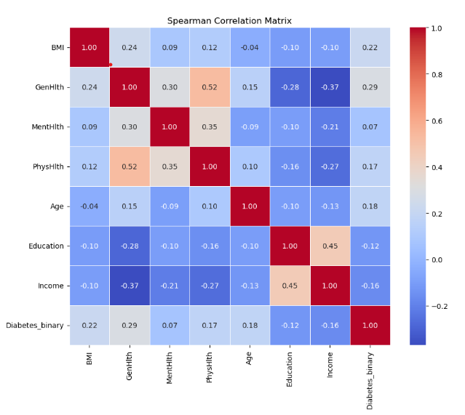
Spearman Correlation Matrix for Numerical Data
Interpretation of Correlation:
Strong Correlation (|corr| ≥ 0.7): Features are highly correlated.
Moderate Correlation (0.3 ≤ |corr| < 0.7): Features show a moderate relationship.
Weak Correlation (|corr| < 0.3): Features have little to no linear relationship.

Slide 23
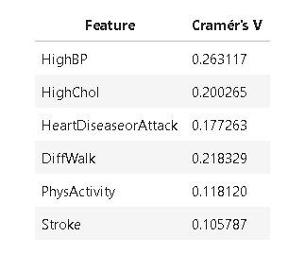
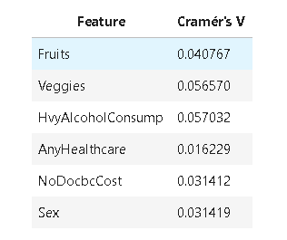
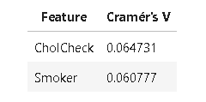
Statistical Analysis For Categorical Data
Impactful Features | Not Impactful Features | Unknown Impact for Model Building

Slide 24
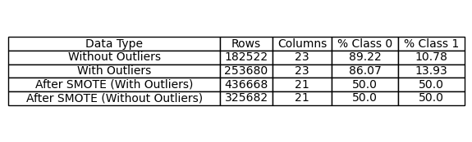
Data Preparation

Slide 25
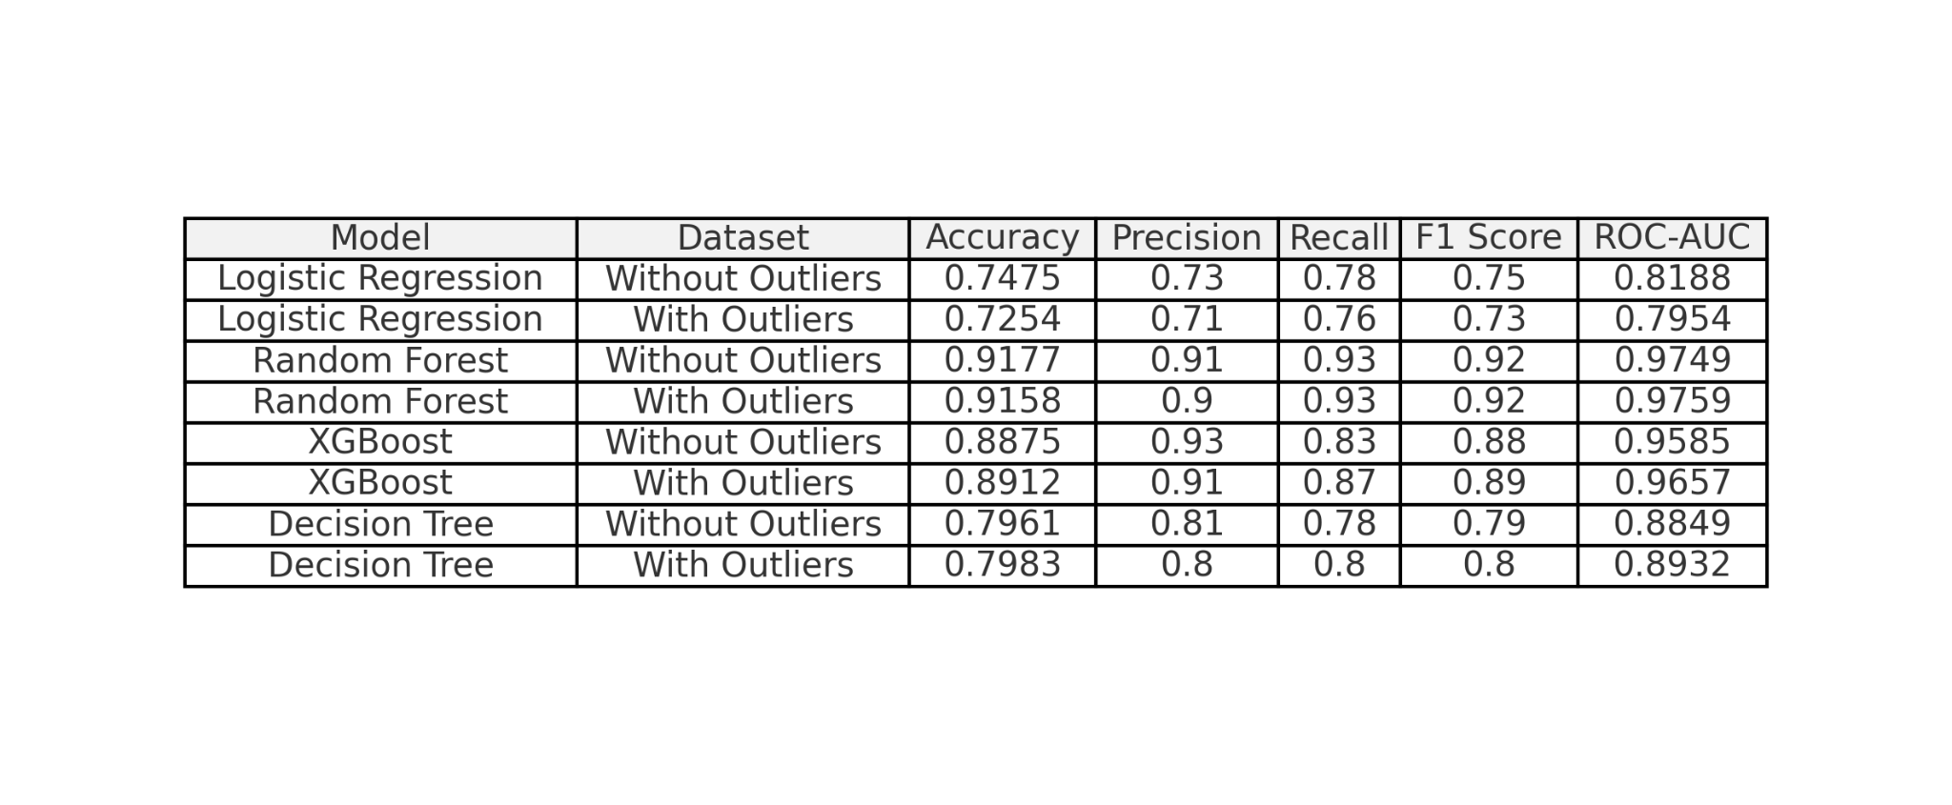
Data Modelling

Slide 26
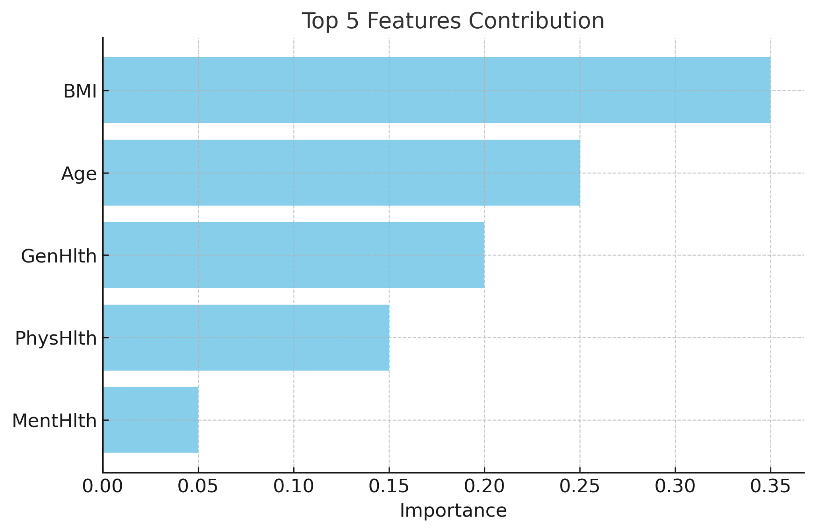

Slide 27
Model deployment
Selected the Random Forest model for deployment
Highest Recall 93% - reduces False negatives (3487 records).
False negatives : chance of diabetes patients being identified as non - diabetic.
Highest Accuracy : 91%
High F1 score : 92%
High ROC - AUC curve : 97.5%

Slide 28
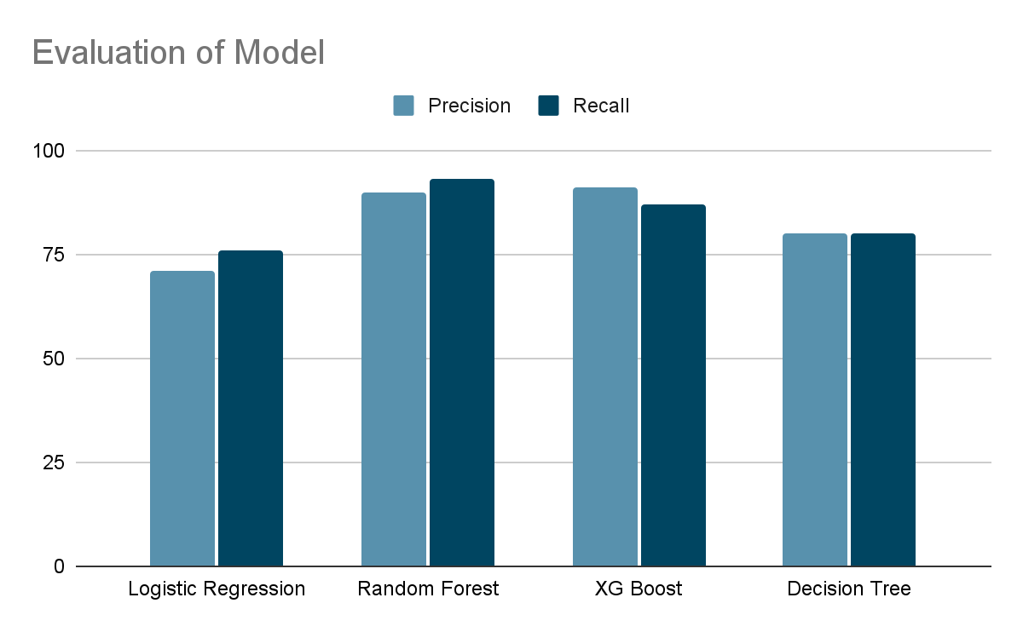

Slide 29
Performance tuning of Random Forest model
Deployed Random Search CV to obtain best parameters for higher recall.
Best parameters
n estimators : 100
Min_samples_split : 2
Min samples lea : 1
Max features : log2
Max depth : 30
Bootstrap : True
Best recall score: 92.5%

Slide 30
Conclusion
Summary of the project outcome
Successful Prediction: Developed machine learning models (Random Forest) with high accuracy (>90%) in predicting diabetes risk.
Key Risk Factors Identified: Analysis revealed important risk factors, including high BMI, older age, lack of physical activity, and unhealthy diet.
Outlier Impact: Removing outliers resulted in marginal performance improvements, emphasizing the importance of data preprocessing.
Foundation for "Diabetes360": Project provides a strong basis for the "Diabetes360" app, enabling personalized risk assessment and targeted interventions.

Slide 31
Future works
Incorporate Genetic Data: Include genetic and family history information to enhance prediction accuracy.
Expand Dataset: Utilize a larger, more diverse dataset to improve model generalizability and robustness.
Address Class Imbalance: Explore advanced techniques (oversampling, undersampling) to further improve prediction of the minority class (those with diabetes).

Slide 32
SARAVANAVEL KALPANA REVATHI,
NIGAM HARSH DILIP KIRAN,
NILADRI ROY, PALLAVI
JAVERIYA FIRDOSE , MOHAMMED HASHIR
SOMANTHA ROY
Mentor
KARTHIK ANAND

